Slide 1
SIT113 Cloud Computing and Virtualisation
Week 7, Class 2
Cloud Technologies and Mechanisms

Slide 2
Outline
Cloud Mechanisms
Specialised Cloud Mechanisms (Chapter 8)
Cloud Management Mechanisms (Chapter 9)

Slide 3
Specialised Cloud Mechanisms (Chapter 8)
Automated Scaling Listener
Load Balancer
SLA Monitor
Pay-Per-Use Monitor
Audit Monitor
Failover System
Hypervisor
Resource Cluster
Multi-Device Broker
State Management Database

Slide 4
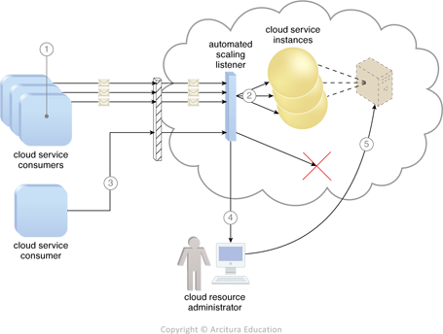
Automated Scaling Listener

Slide 5
Automated Scaling Listener
monitors and tracks communications between cloud service consumers and cloud services for dynamic scaling purposes
Typically deployed near the firewall in the cloud to track workload by monitoring the volume of cloud consumer-generated requests
Responses include scaling IT resources out or in, notifications sent to the cloud consumer

Slide 6
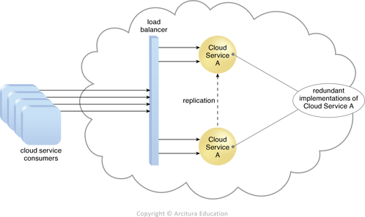
Load Balancer

Slide 7
Load Balancer
balances workload across two or more IT resources to increase performance and capacity beyond a single IT resource
Asymmetric distribution: larger workloads issued to IT resources with higher processing capacities
Workload prioritisation: workloads scheduled, queued, discarded, and distributed according to priority level
Content-aware distribution: requests distributed to different IT resources depending on request content

Slide 8
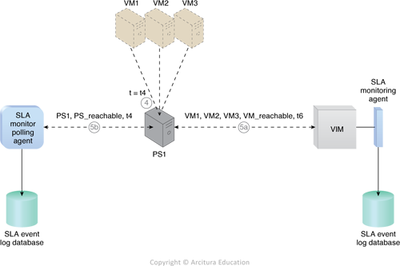
SLA Monitor

Slide 9
SLA Monitor
observes runtime performance of cloud services to ensure they fulfil contractual QoS requirements as published in SLAs
Data collected is aggregated into reporting metrics
Can proactively repair or failover cloud services when exception conditions occur

Slide 10
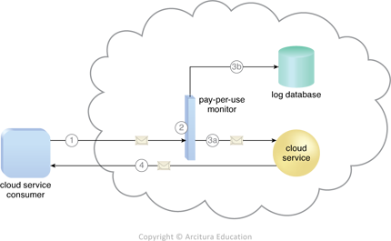
Pay-Per-Use Monitor

Slide 11
Pay-Per-Use Monitor
measures cloud-based IT resource usage for fee calculations and billing purposes
includes:
request/response message quantity
transmitted data volume
bandwidth (data transfer rate)

Slide 12
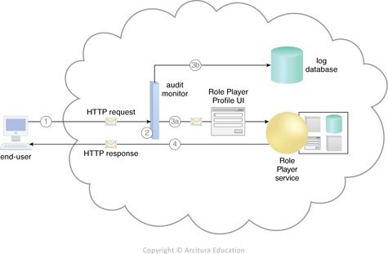
Audit Monitor

Slide 13
Audit Monitor
collects data (audit tracking data) for networks and IT resources in support of regulatory and contractual obligations

Slide 14
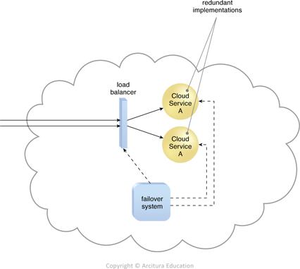
Failover System

Slide 15
Failover System
increases reliability and availability of IT resources through redundancy
Automatically switches over to a redundant or standby IT resource instance when currently active IT resource becomes unavailable

Slide 16
Failover System
Approaches:
Active-Active: redundant IT resources actively serving workload synchronously using load balancing
Active-Passive: standby or inactive IT resources activated upon failure of active IT resource

Slide 17
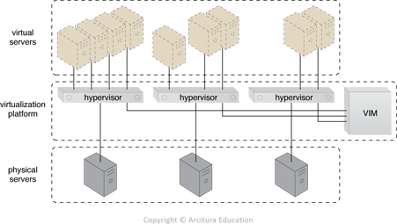
Hypervisor
fundamental part of virtualization infrastructure
generates virtual server instances

Slide 18

Resource Cluster

Slide 19
Resource Cluster
geographically diverse cloud-based IT resources are combined into groups to improve allocation and performance, examples:
Server Cluster: physical or virtual servers clustered to increase performance and availability
Database Cluster: improve data availability by synchronising data stored in different devices
Large Dataset Cluster: implement data partitioning and distribution to efficiently divide large data sets without compromising data integrity or computing accuracy

Slide 20
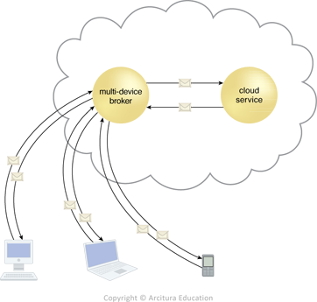
Multi-Device Broker
runtime data transformation to allow cloud services access to a wider range of cloud service consumer programs and devices

Slide 21
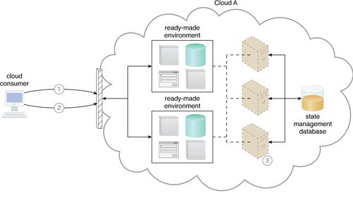
State Management Database
storage device for storing state information instead of caching state data in memory

Slide 22
Cloud Management Mechanisms (Chapter 9)
Remote Administration System
Resource Management System
SLA Management System
Billing Management System

Slide 23
Remote Administration System
External configuration and administration of cloud-based IT resources
Primarily two types of portal:
Usage and Administration Portal: management controls for IT resources
Self-Service Portal: a “shopping portal” allowing cloud consumers to choose cloud-based IT resources for provisioning

Slide 24
Remote Administration System
Common tasks include:
Configuring cloud services
Provisioning/releasing IT resources
Monitoring status, usage, performance, QoS and SLA fulfilment
Managing leasing costs, usage fees, user accounts, security credentials, authorization, access control
Tracking internal/external access to leased services
Planning and assessing IT resource provisioning
Capacity planning

Slide 25
Resource Management System
Managing templates used to create instances e.g., virtual server images
Allocating/releasing virtual IT resources in response to start/pause/resume/terminate of virtual IT resource instances

Slide 26
Resource Management System
Coordinate IT resources for other mechanisms such as resource replication, load balancing, failover systems
Enforcing usage and security policies
Monitoring operational conditions of IT resources

Slide 27
SLA Management System
Includes repository for storing/retrieving SLA data
one or more SLA monitoring mechanisms collect SLA data
Metrics monitored, for individual cloud services, are aligned with SLA guarantees

Slide 28
Billing Management System
Collection and processing of usage data that are relevant for accounting and billing

Slide 29
Summary
Cloud Mechanisms
Specialised Cloud Mechanisms (Chapter 8)
Cloud Management Mechanisms (Chapter 9)

